Slide 1

THE BRINMONT
MANAGEMENT GROUP
Digital presence and
business growth
Websites, campaigns and AI systems
for businesses of every size
Starting prices in Mexican pesos
VAT included. Scope as quoted

Slide 2

Promotional
video
THE BRINMONT MANAGEMENT GROUP
Professional website
From $7,000
Web design, branding
and e-commerce
Up to 5 pages.
Mobile-friendly design.
WhatsApp contact.
One-time build fee. Scope as quoted.
30-second video with music.
Open using the link below.
Original Spanish version.
PRICES IN MXN INCLUDING VAT
Open video (30 seconds)
Visit the Brinmont website
THE BRINMONT MANAGEMENT GROUP
02

Slide 3

Small businesses and international companies
Local businesses
Google presence, a website and direct contact.
Growing companies
Lead generation and sales follow-up.
International brands
Market-specific campaigns and connected systems.
We adapt the strategy to each business's industry, market and capacity to serve customers.
THE BRINMONT MANAGEMENT GROUP
03

Slide 4

Industries we serve
Industry expertise for small businesses and international companies.
01
Marine and yachts
07
Beauty and wellness
02
Automotive
08
Retail and e-commerce
03
Real estate
09
Equipment and industry
04
Medicine and healthcare
10
Professional services
05
Hotels and hospitality
11
Construction
06
Food and agriculture
12
Technology
Explore our industries online
THE BRINMONT MANAGEMENT GROUP
04

Slide 5

Two options for your business
PROFESSIONAL WEBSITE
PROFESSIONAL ONLINE STORE
FROM
FROM
$7,000
$12,500
MXN, one-time payment, VAT included
MXN, one-time payment, VAT included
Present your services and receive
inquiries via a form or WhatsApp.
Showcase your catalog and receive
orders with online payment.
Website and domain from $550 MXN/month. All prices include VAT.
THE BRINMONT MANAGEMENT GROUP
05

Slide 6

Professional website
From $7,000 MXN
One-time payment including VAT
Up to 5 pages
Home, about, services, gallery and contact.
Mobile and desktop design
One language: Spanish. One brand and business.
Direct contact
Contact form, social links and WhatsApp.
Launch and review
2 revision rounds and navigation testing.
THE BRINMONT MANAGEMENT GROUP
06

Slide 7
Initial SEO and Google Business Profile
Website code
Google profile
Page titles and descriptions.
Headings, links and alternative text.
1 business or location: category, description,
services, hours and up to 10 photos.
Searches in your market
Technical setup
Up to 5 search topics focused on
your service and one city or area.
Sitemap, Search Console and
structured data where applicable.
Google controls verification and rankings. Profiles require an eligible business serving customers in person.
Verification guidance is included, with no guarantee of approval.
THE BRINMONT MANAGEMENT GROUP
07

Slide 8

Brand identity and business files
1 refined logo
Existing logo refinement and basic vectorization.
3 static graphics + 1 banner
The banner includes 2 social media sizes.
1 graphic adapted for print
One-sided A5 flyer based on the 3 graphics.
Digital and vector files
PNG/JPG, SVG and PDF. 2 revision rounds.
Photos are not vectors. Final print preparation follows the printer's specifications.
THE BRINMONT MANAGEMENT GROUP
08

Slide 9

Professional online store
From $12,500 MXN
One-time payment including VAT. Includes the branding package and initial SEO.
Initial catalog
Up to 20 products and 5 categories.
Product variants
Up to 40 variants in total.
Cart and payment
1 payment gateway and a test purchase.
Shipping and administration
1 shipping setup and 60 minutes of training.
THE BRINMONT MANAGEMENT GROUP
09

Slide 10
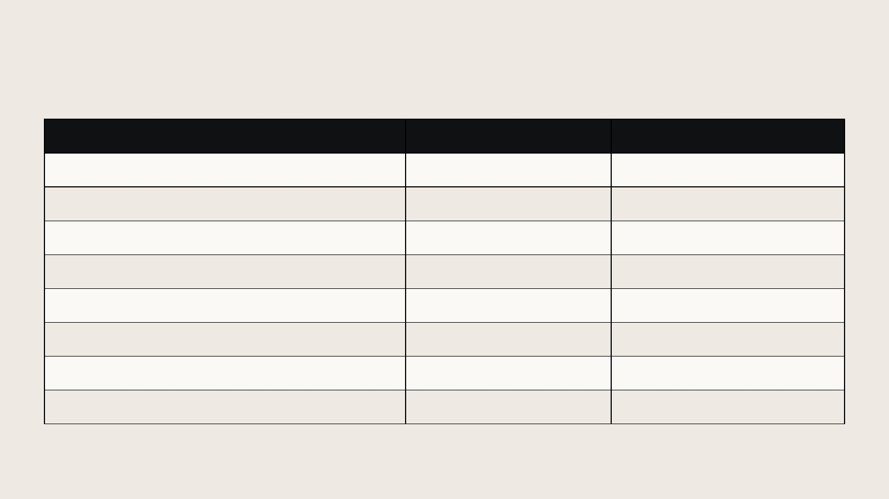
Comparison of included services
Deliverable | Website | Online store
Build, one-time payment | From $7,000 | From $12,500
Informational pages | Up to 5 | Up to 5 + catalog
Products / variants | Not included | Up to 20 / up to 40
Cart and online payment | Not included | 1 standard gateway
Initial SEO and Google profile | Included* | Included*
Logo refinement + 3 graphics + banner | Included | Included
Build revisions | 2 rounds | 2 rounds
Website and domain, monthly | From $550 | From $550
Starting prices in MXN including VAT. *Google profile subject to eligibility and verification. Limits apply.
THE BRINMONT MANAGEMENT GROUP
10

Slide 11

Monthly website and domain service
FROM
1 website and 1 domain
$550
Hosting, SSL and a standard .com domain.
Technical continuity
Domain renewal while the plan remains active.
MXN / month
Backup and maintenance
VAT included
Starting when the website launches
Weekly backups with 30-day retention.
Minor changes
Up to 30 minutes per month, with no rollover.
THE BRINMONT MANAGEMENT GROUP
11

Slide 12
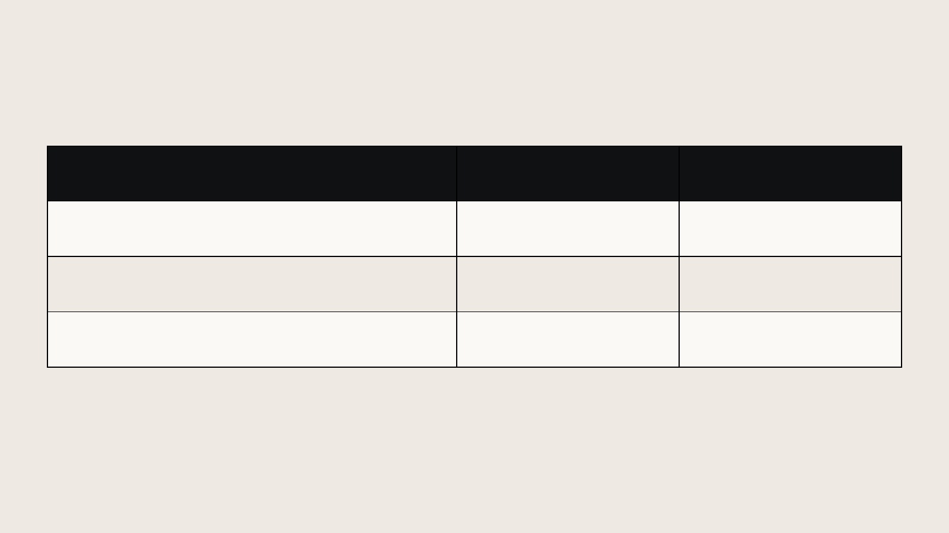
Sample investment at starting prices
Item | Website | Online store
Build from | $7,000 | $12,500
12 months from $550/month | $6,600 | $6,600
First year from | $13,600 | $19,100
All amounts are in MXN and include VAT.
Example includes 12 months of service, excluding extras, campaigns and external costs.
The final quote depends on the scope, platform and services selected.
THE BRINMONT MANAGEMENT GROUP
12

Slide 13
Campaigns for every business size
FROM
UP TO
$10,000
$25,000,000
MXN per month, including VAT
Programs for small businesses, growing companies and international
operations, based on objectives and scope.
The quote itemizes advertising, management, production and technology.
We confirm the total and included services before starting.
THE BRINMONT MANAGEMENT GROUP
13

Slide 14
Discounts when combining services
Discounts available
Combine your website or store with a growth program.
SEO for your market
Acquisition and retention
Content and optimization for searches
that matter to your customers.
Lead generation, follow-up
and social media campaigns.
Discounts depend on the combined services, scope and duration.
We confirm the amount and terms in writing in your proposal.
THE BRINMONT MANAGEMENT GROUP
14

Slide 15
Targeted SEO and social media campaigns
SEO based on search intent
Ads for the right audience
Pages and content by service or market.
Technical review and ongoing improvement.
Targeting by location and interests.
Messages tailored to each offer.
Creative development and testing
Budget optimization
Graphics, videos and multiple versions
to compare audience response.
Review inquiries, contacts and sales
to refine channels and ads.
The proposal defines channels, assets and frequency. Ongoing SEO and campaigns are quoted separately.
THE BRINMONT MANAGEMENT GROUP
15

Slide 16
Acquiring and retaining new customers
01
Lead generation
Ads and contact pages with a clear offer.
02
Qualification and follow-up
CRM records, initial questions and sales assignment.
03
Customer conversion
Appointments, quotes and follow-up reminders.
04
Repeat purchases and reactivation
Welcome messages, after-sales support and offers based on customer history.
Channels and automation are configured to match the project and the client's permissions.
THE BRINMONT MANAGEMENT GROUP
16

Slide 17

AI agents for customer service and sales
Initial assistance
Responses using approved information about your business.
Lead qualification
Questions to understand needs and priorities.
Scheduling and reminders
Appointment scheduling through the agreed tools.
Team support
Conversation records and handoff to a team member.
Text or voice agents. Setup, integrations and usage charges are quoted based on use.
THE BRINMONT MANAGEMENT GROUP
17

Slide 18
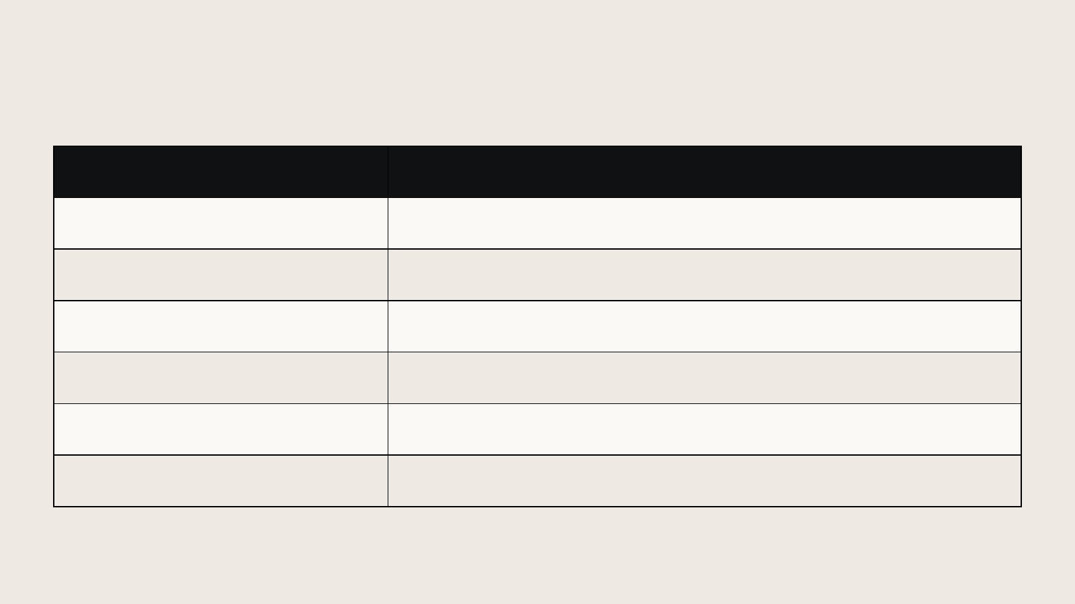
Custom automation and systems
System | Applications by project
CRM and sales | Leads, opportunities, tasks and follow-up.
Web and mobile apps | Customer portals and internal tools.
Commerce and bookings | Catalogs, orders, appointments and service workflows.
Business operations | Inventory, purchasing and team coordination.
Data and dashboards | Metrics, reports and visibility into operations.
Platform integrations | Data exchange and fewer repetitive tasks.
Implementation and maintenance quotes depend on modules, users, integrations and volume.
THE BRINMONT MANAGEMENT GROUP
18

Slide 19

Master Desk: operations management
Sales and customers
Sales follow-up and team coordination.
Inventory and purchasing
Stock, orders and visibility into inventory movements.
Commissions and finance
Calculations and reports based on business rules.
Metrics and automation
Dashboards, alerts and workflows across teams.
Conceptual visualization of the platform
Request a Master Desk demo and scope
THE BRINMONT MANAGEMENT GROUP
19

Slide 20
Sales growth and connected operations
We have helped clients grow from
to
US$200,000
US$1,000,000
in monthly sales
in monthly sales
The right campaigns and strategies
Centralized data and connectivity
Targeted campaigns and sales strategies
to attract customers and turn
opportunities into sales.
Coordinated operations, clear responsibilities
and teams working together
in real time.
We simplify business owners' lives: less operational workload
and greater control over responsibilities and their teams' work.
THE BRINMONT MANAGEMENT GROUP
20

Slide 21
How we connect campaigns to sales
Measurable acquisition
We link ads and forms to each contact's source.
Sales follow-up
The CRM records appointments, quotes and each
opportunity's stages.
Reconciled sales
We match orders to contacts and check duplicates and
returns.
Data-informed decisions
We review cost per customer, attributed sales and repeat
purchases to adjust the plan.
Measurement depends on available data and the agreed attribution model.
THE BRINMONT MANAGEMENT GROUP
21

Slide 22
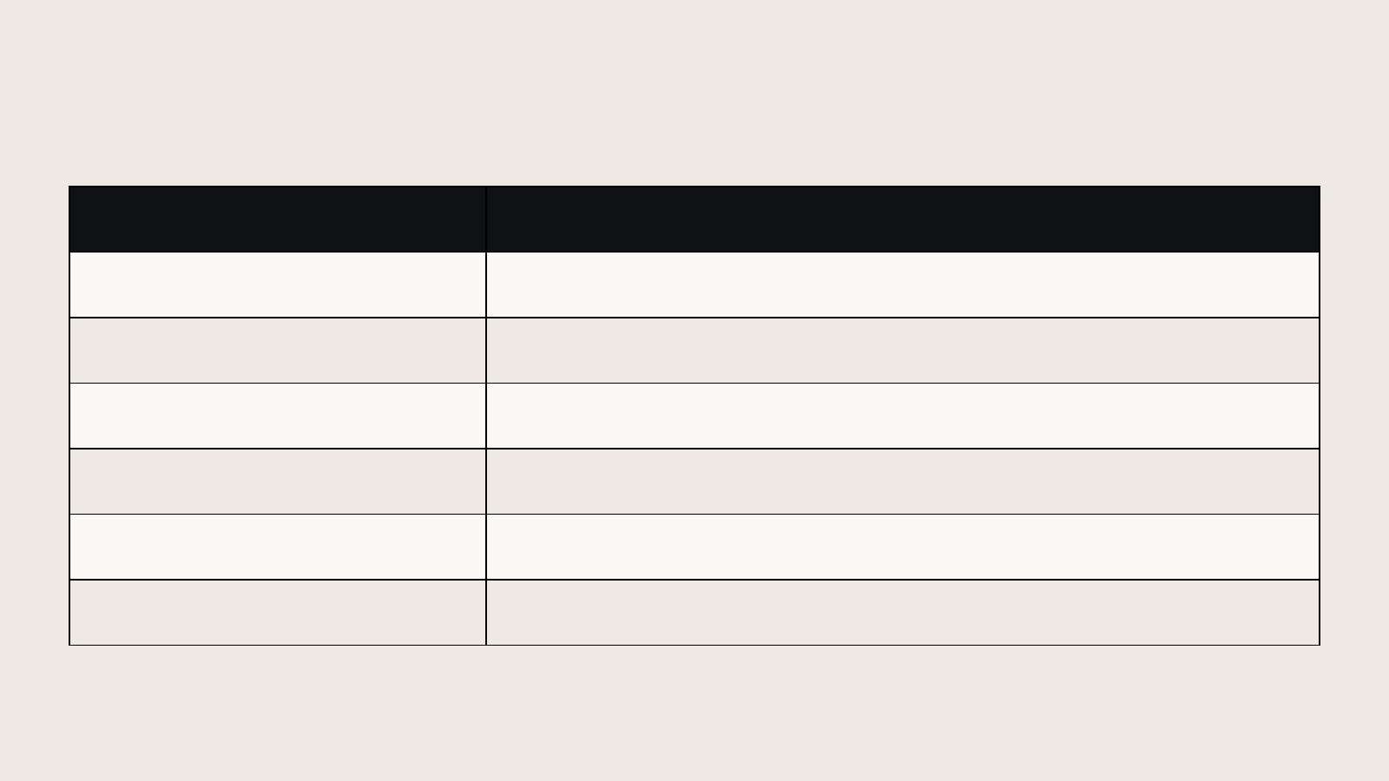
Additional services: clear limits
Quoted separately | When it applies
More content | More than 5 pages, 20 products or 40 variants.
More design | New logo, complex illustration or additional assets.
More revisions | From the 3rd round or changes to the approved concept.
Advanced features | Bookings, CRM, AI, Master Desk and custom integrations.
Other markets | Another language, currency, brand or Google location.
Ongoing work | Monthly SEO, campaigns, posts and social media support.
Each extra requires a written scope, price and timeline before work begins.
THE BRINMONT MANAGEMENT GROUP
22

Slide 23
External costs and client materials
Software, AI and payments
Production and media
Licenses, AI usage, messaging
and payment fees, depending on the project.
Advertising, photography, video and printing
according to the contracted budget.
Information and permissions
Policies and operations
The client provides copy, photos, prices,
access and rights to use the materials.
The client approves sales policies and
manages orders, inventory and service.
Payment gateway and Google approvals depend on their respective providers.
THE BRINMONT MANAGEMENT GROUP
23

Slide 24
Work process and delivery
01
Project definition
Package, pages, materials and access. Written scope.
02
Design and review
Visual proposal and up to 2 rounds of consolidated revisions.
03
Build and testing
Mobile review, links, forms and a test purchase.
04
Launch and files
Delivery of graphics, website access and monthly service activation.
The timeline and payment terms are agreed once materials and scope are confirmed.
THE BRINMONT MANAGEMENT GROUP
24

Slide 25

Let's discuss your project
Website from $7,000 MXN
Online store from $12,500 MXN
Monthly service from $550 MXN
VAT included. Campaigns and systems quoted separately
Camilo Bringuier on WhatsApp
786.736.0346
Paulina Bringuier on WhatsApp
786.736.0346
Send an email
info@thebrinmontmgmtgroup.com
thebrinmontmgmtgroup.com

